Slide 1


Team: Oana GIRJAN, Ionut STAN, Gheorghe MOSTEORU, Cristi BACA, Vasile MADINCEA, Daniel CIOATA

Slide 2

Have you ever …
found a lost pet wondering around and did not know how to help it find its family?
passed by a location only to find out later about the show taking place inside?
visited a new town only to miss the best steak around?
found you out in a dangerous situation being frustrated not knowing about it earlier?
wanted to notify the community about all these?

Slide 3
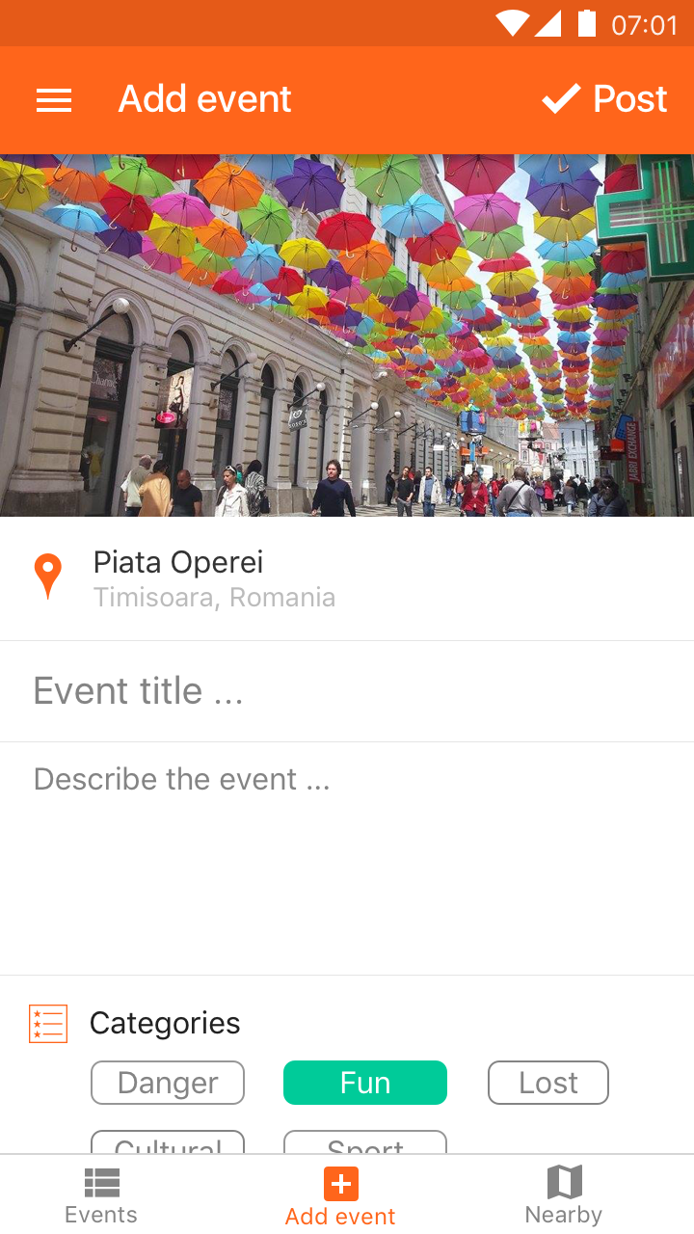
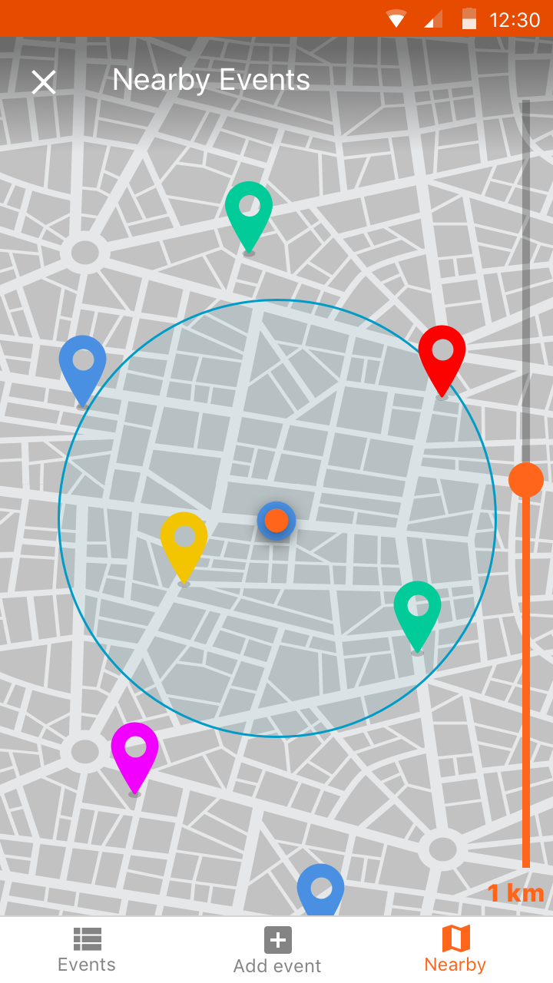

Slide 4
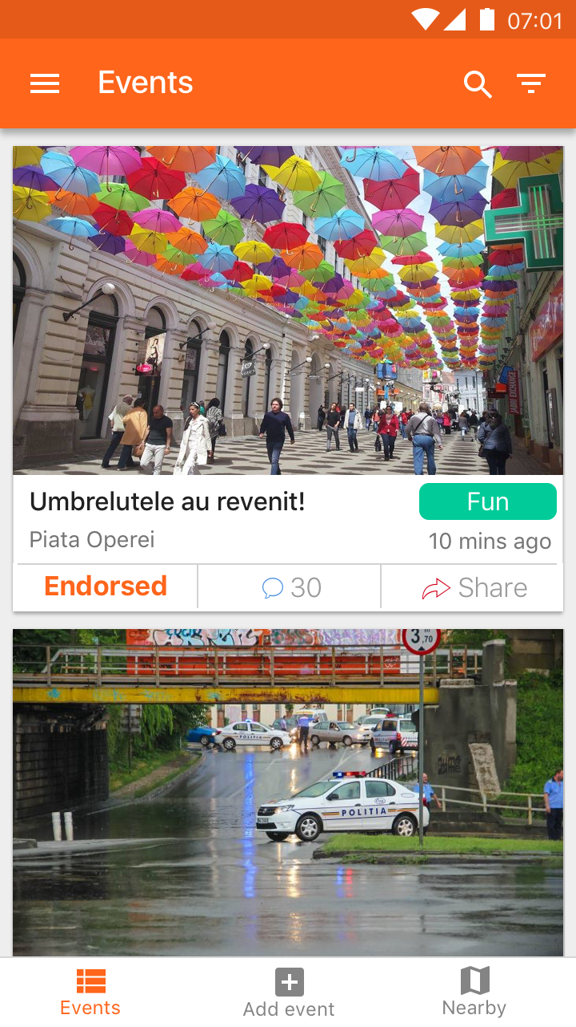
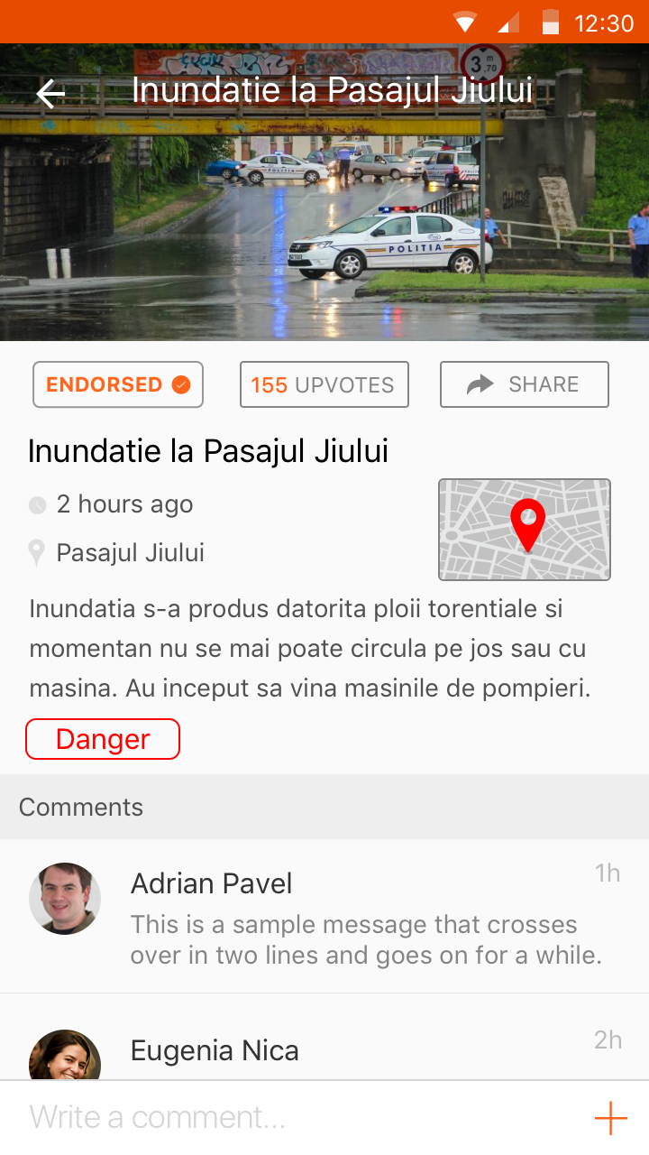

Slide 5
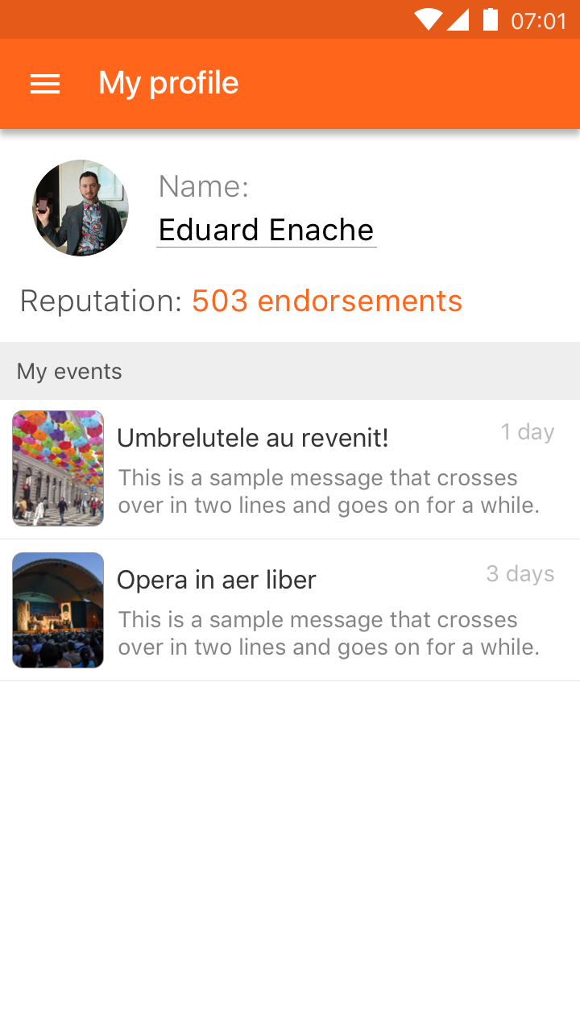
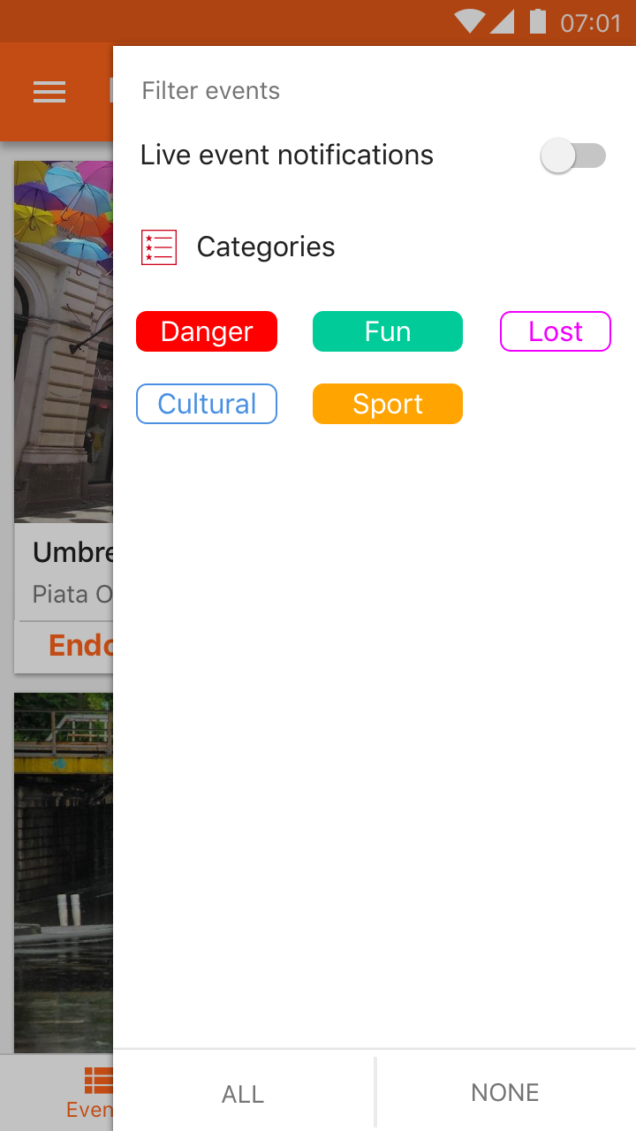

Slide 6

by HACKABIT

Slide 7
by HACKABIT

